Slide 1

Behavioral Insights into Political Polarization in Christian Communities through Computational Modeling
Eric Araújo
Computer Science – Calvin University

Slide 2
Good afternoon, everyone. My name is Eric Araújo, and I’m a professor of Computer Science at Calvin University. I’m originally from Brazil, and my research centers on complex systems and agent-based modeling. Today, I want to share how computational modeling can help us understand—and maybe even address—the growing challenge of political polarization in Christian communities. This is a topic that’s close to my heart, and I believe it’s crucial for the future of our churches.

Slide 3
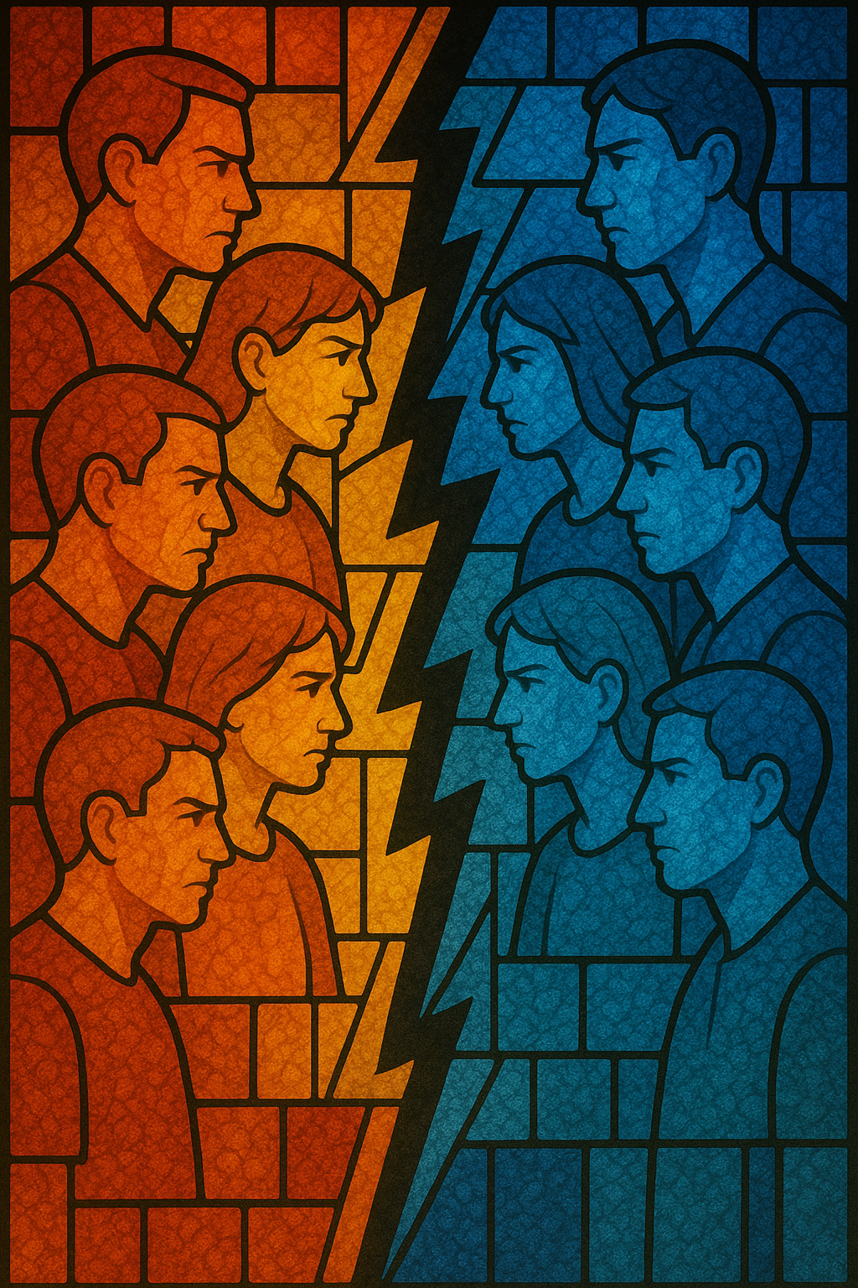
Why study polarization in Christian communities?

Slide 4
We live in a time when political polarization is dividing communities, including our churches. This isn’t just about politics—it’s about how we relate to one another, how we worship, and how we build community. One major trend is “de-churching,” where people, especially younger generations, are leaving traditional church settings. This reflects deeper changes in society and highlights the generational divides that shape our faith communities.

Slide 5
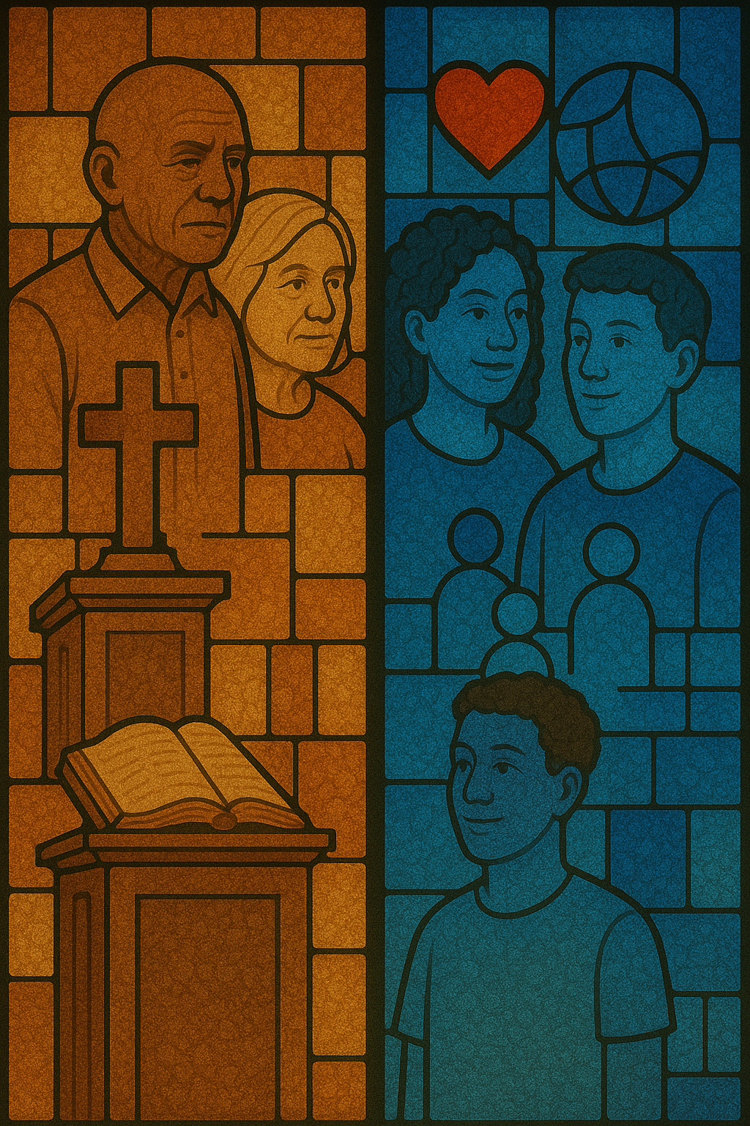
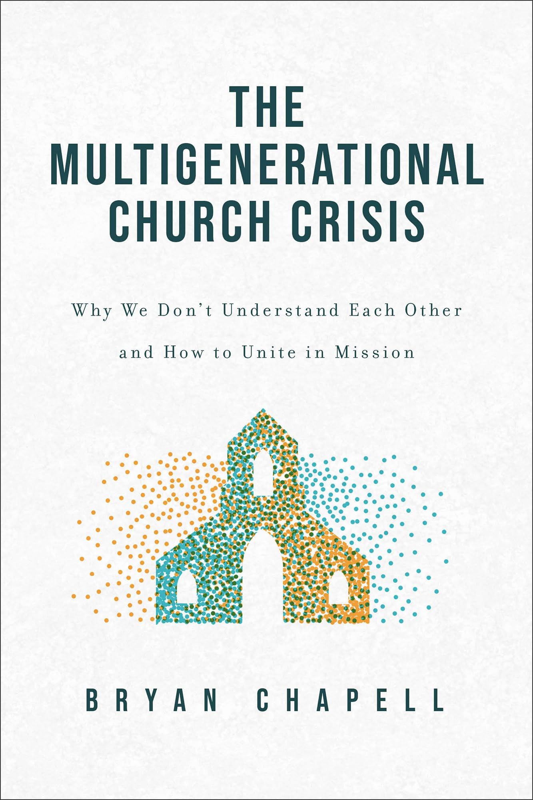

Slide 6
Bryan Chapell, in his book The Multigenerational Church Crisis, emphasizes the importance of understanding the perspectives and experiences of different age groups to foster unity and collaboration within congregations. He also points out that the de-churching process is not exclusive to younger generations, but also affects older generations, leading to a complex interplay of beliefs and practices within the church community.

Slide 7
Let’s look at some of the key differences between generations that contribute to polarization:

Slide 8
Aspect | Older Generation (Fifties and Older) | Younger Generation (Forties and Younger)
Perception | "We are (were) a majority" | "We are a minority"
Mission | Take control of culture | Make credible our faith
Means | Bring a halt to: abortion homosexual agenda Pornography illegal drugs Gambling green movement illegal immigration racial discrimination | Help with: adoption and foster care care for and witness to LGBTQ+ persons liberating victims of sex trafficking and sex addiction substance addiction counseling and rescue gaming and gambling addictions creation care refugee compassion and care racial reconciliation and justice

Slide 9
Even though recent research has shown that the church decline stabilized in the last years, it also shows a division and a preference for different types of churches based on demographic factors such as age, gender, and political affiliation. This division is particularly pronounced among younger generations, who are more likely to seek out churches that align with their values and beliefs.

Slide 10
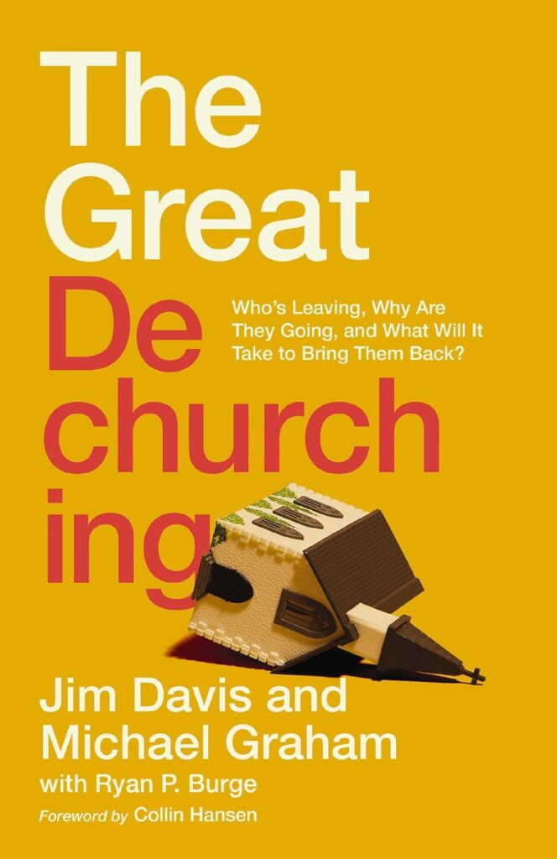

Slide 11
Jim Davis and Michael Graham, in their book "The Great De-Churching," argue that the decline in church attendance is more than just numbers—it’s a reflection of deeper shifts in values and community engagement.

Slide 12
“The early church that used to cheerfully bring the poor and destitute into their lives now often serves them at a distance through benevolence programs without fully embracing them into their church family.” p. 27

Slide 13
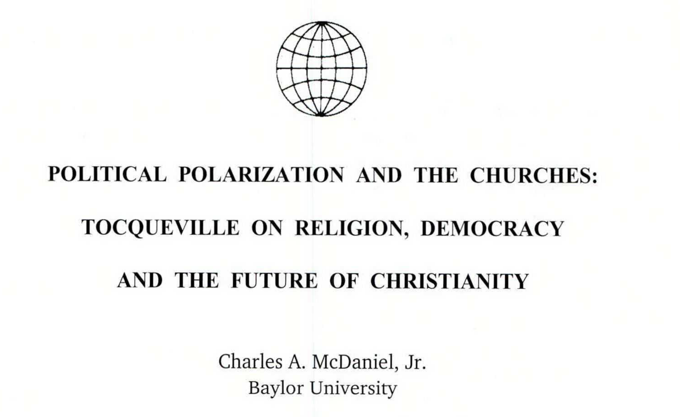

Slide 14
Charles McDaniel Jr., drawing on Tocqueville, reminds us that:

Slide 15
"The less religion and its ministers are mixed up with government... the more influential religious ideas will become."

Slide 16


Slide 17
Dan White Jr., in "Love Over Fear," gives us a powerful definition of polarization:

Slide 18
"Polarization takes people that have something in common, emphasizes their differences, hardens their differences into disgust, and turns their disgust into blatant hatred... shaping us for only two options—'our side' or 'their side.'"

Slide 19
He also shares a real-life example:
"I grieved that both of these folks could not stay in the mix together. They were repelled by each other. Rather than moving toward one another, despite their differences, they chose more distance."
These insights help us see the complexity of the problem and the urgent need for new approaches.

Slide 20
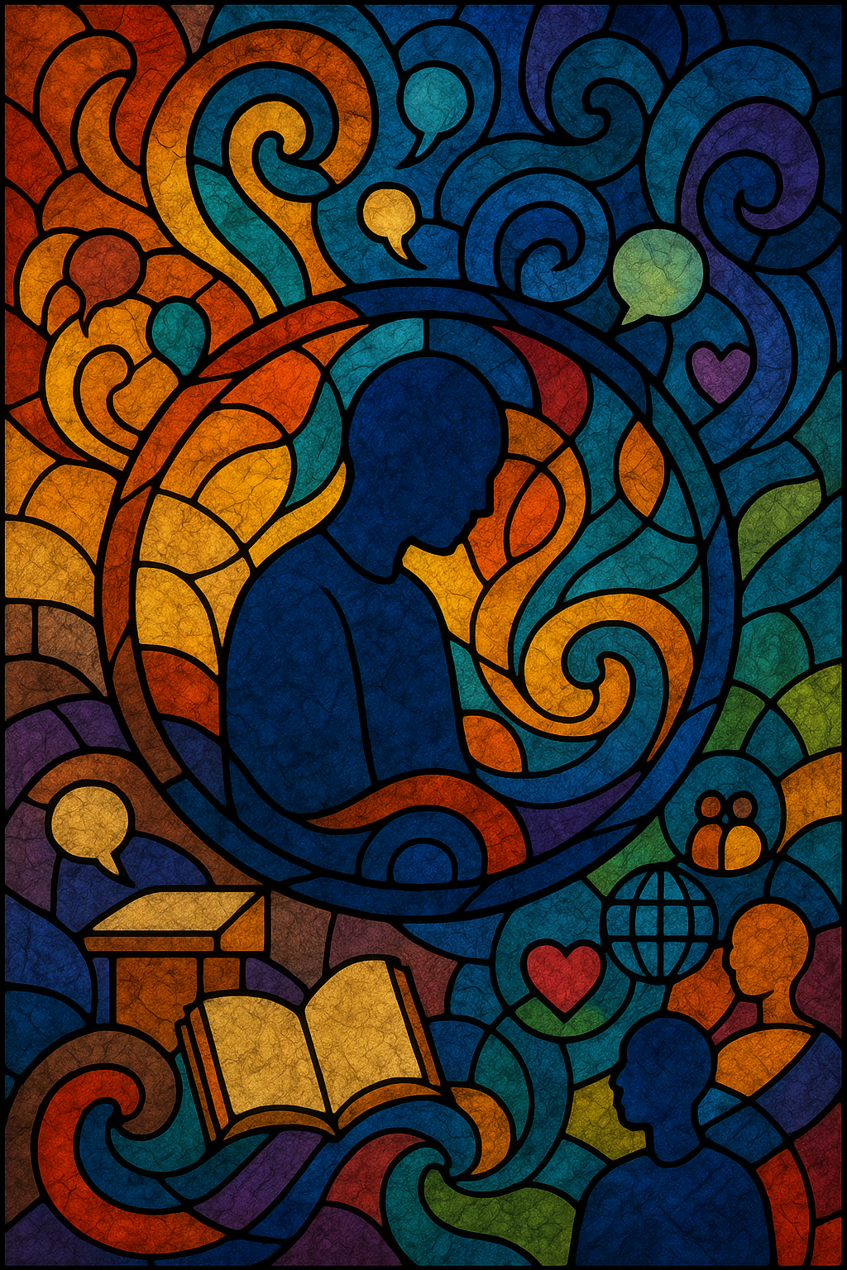
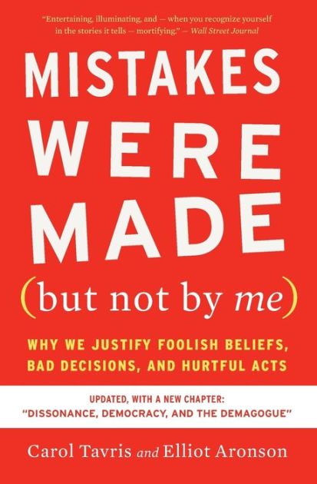
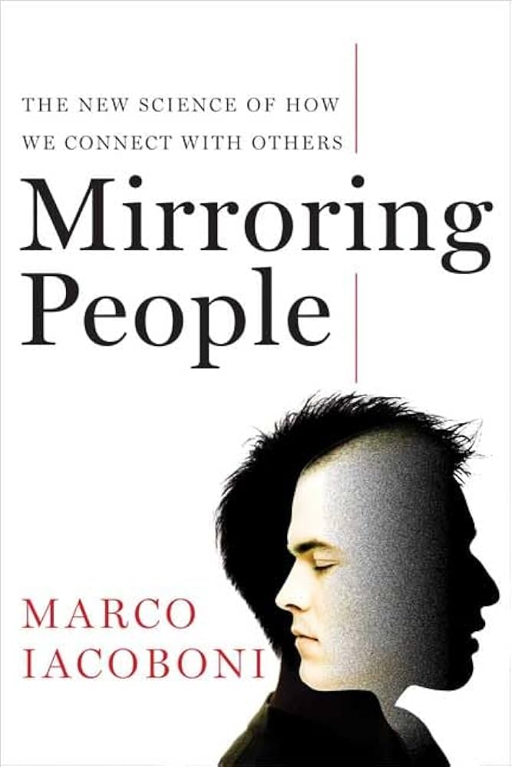

Slide 21
There is a common understanding that people's opinions, beliefs, and behaviors are not static, but rather dynamic and subject to change over time.
This is particularly true in the context of political polarization, where individuals' views can shift in response to various factors, such as social influences, media exposure, and personal experiences.

Slide 22
But there is also an understanding that changes don't come easily, and that people are often resistant to changing their opinions, especially when they are strongly held.
This resistance can be driven by a variety of factors, including cognitive biases, social pressures, and emotional attachments to one's beliefs.

Slide 23
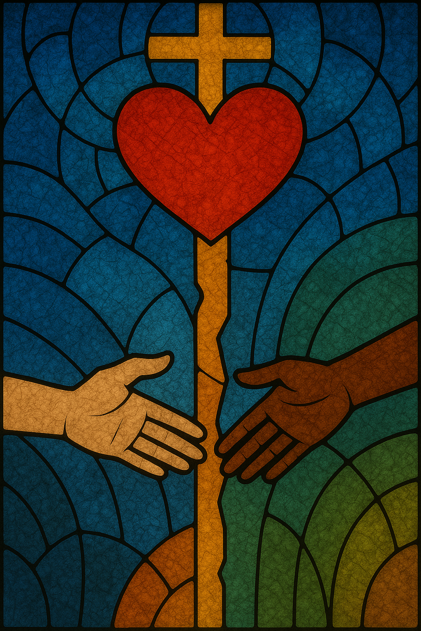

Slide 24
As Christians, we face a unique challenge. In the context of Christian communities, this resistance to change can be particularly pronounced, as individuals may feel a strong sense of identity and belonging tied to their religious beliefs. This can make it difficult for them to engage with differing perspectives or to consider alternative viewpoints.

Slide 25
Fortunately, we are people of the Bible. We take Jesus' words seriously, even when they seem too naive or impractical.

Slide 26
"You have heard that it was said, 'Love your neighbor and hate your enemy.' But I tell you, love your enemies and pray for those who hurt you, that you may be children of your Father in heaven... if you love those who love you, what reward will you get? . . . And if you are hospitable to only your own people, what are you doing more than others?" (Matt. 5:1, 43–48, Msg)

Slide 27
This teaching is radical. It asks us to move beyond comfort and embrace unity and compassion, even when it’s difficult. But how do we do this in a polarized world?

Slide 28
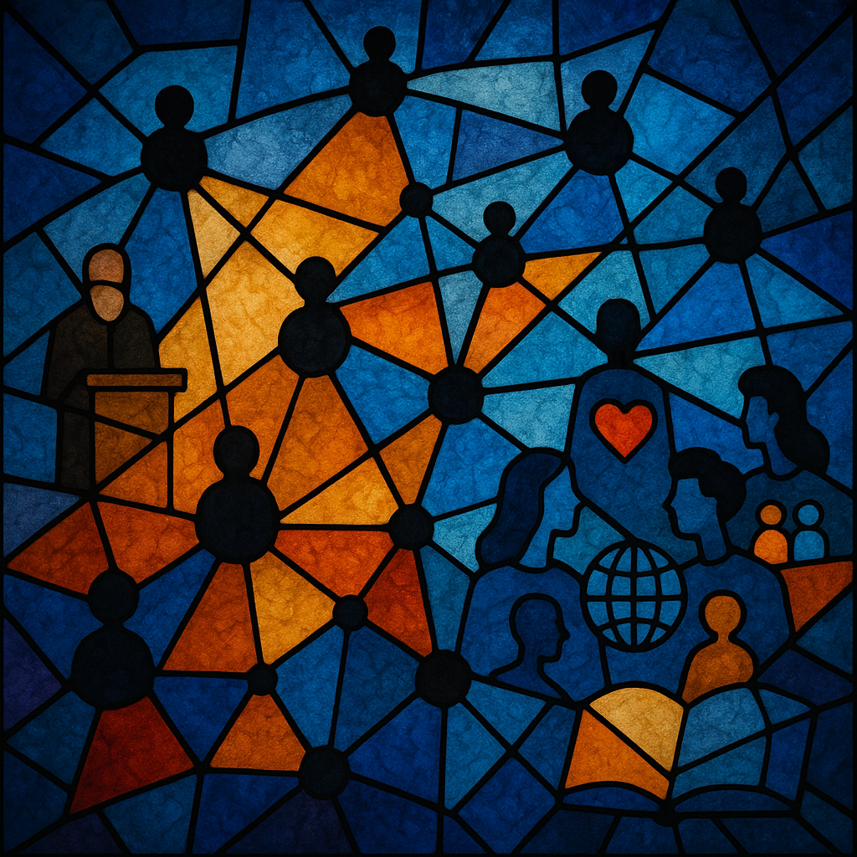

Slide 29
This is where computational modeling comes in. Agent-based models, or ABMs, allow us to simulate the behaviors and interactions of individuals in a community.
By modeling these interactions, we can see how small differences can grow into large-scale polarization. ABMs also let us test different interventions—like increasing tolerance or strengthening social ties—and see what might help build unity in our communities.

Slide 30
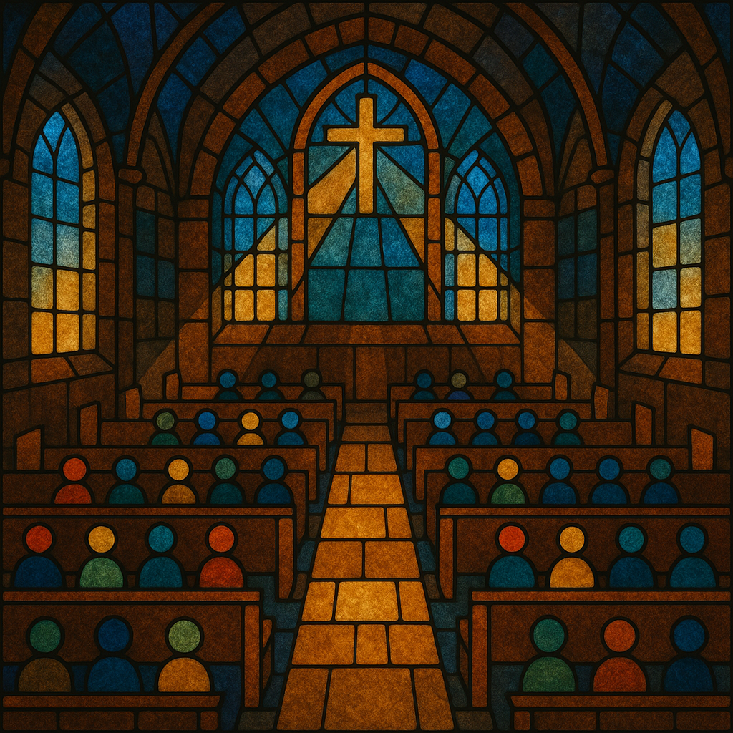

Slide 31
Let me briefly describe the model I built using NetLogo. Imagine a church with 400 seats. Each member is represented as an agent with four main characteristics:

Slide 32
(1) Political leaning, from progressive to conservative
(2) Tolerance for political difference
(3) Activity level, which affects how often they attend
(4) Emotional state, which reflects their well-being

Slide 33
Each week, these agents interact with one another. They form and evolve social ties based on who sits near them, how similar their politics are, and how often they attend. This creates a dynamic social network that changes over time.

Slide 34
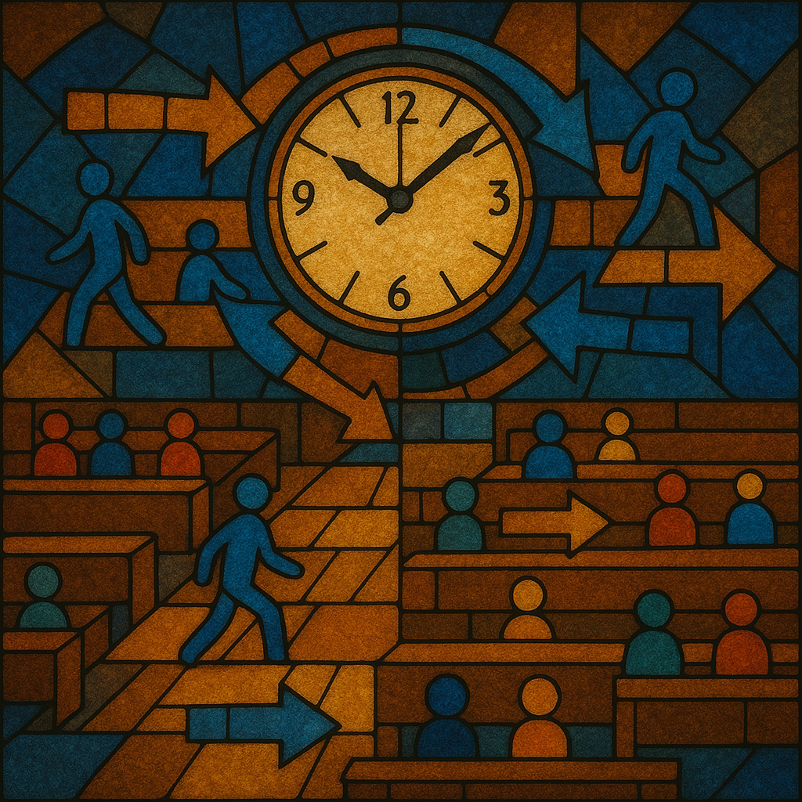
Attendance
Interactions
Emotional State
Ties Evolve

Slide 35
Here’s how a typical week works in the simulation:
First, each member decides whether to attend church, based on their activity level and emotional state.
Those who attend interact with others—prioritizing friends and neighbors, but sometimes meeting new people. The quality of these interactions depends on political similarity and tolerance.

Slide 36
After each interaction, members update their emotional state. Finally, the social network evolves: strong ties get stronger, weak ties may fade, and new connections can form.

Slide 37
The heart of the model is how emotional states are updated. The main equation is:

Slide 38

Core of the model
E = B + αC − βD
Where:
E = Emotional State
B = Base (baseline emotional state)
α = weight for positive connections
C = Connection Score
β = weight for negative interactions
D = Dissimilarity Penalty
Notes:
Slide 10

Slide 39
In simple terms, positive interactions with friends boost well-being, while negative, politically charged interactions reduce it. The model lets us adjust how much friendships and political differences matter, so we can see what happens under different scenarios.

Slide 40
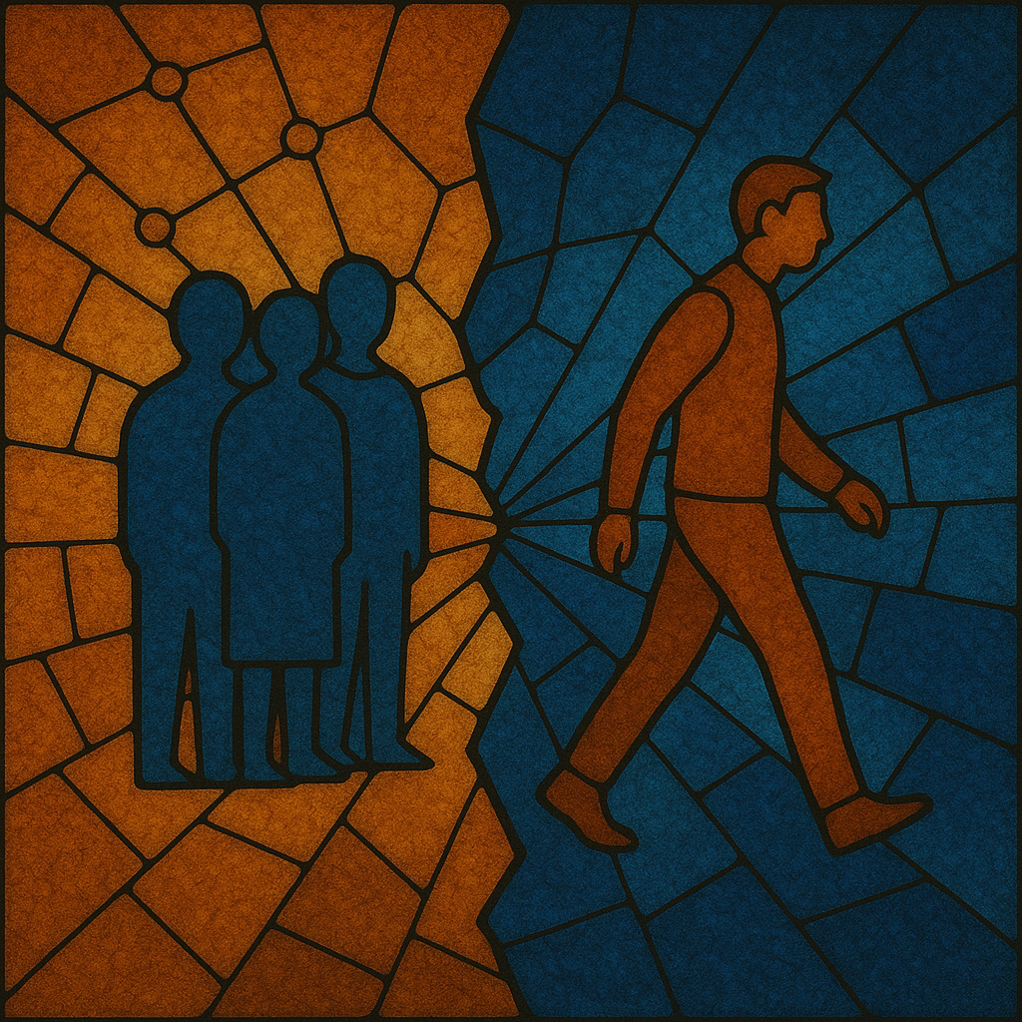
Network fragmentation or clustering

Slide 41
Sometimes, members leave the church in the model. This can happen if their emotional state stays low, if they stop attending for several weeks, or if their activity level drops. When people leave, they break all their social ties and disappear from the community. Over time, we see the network self-organize—often with more political clustering and more departures, especially when tolerance is low.

Slide 42
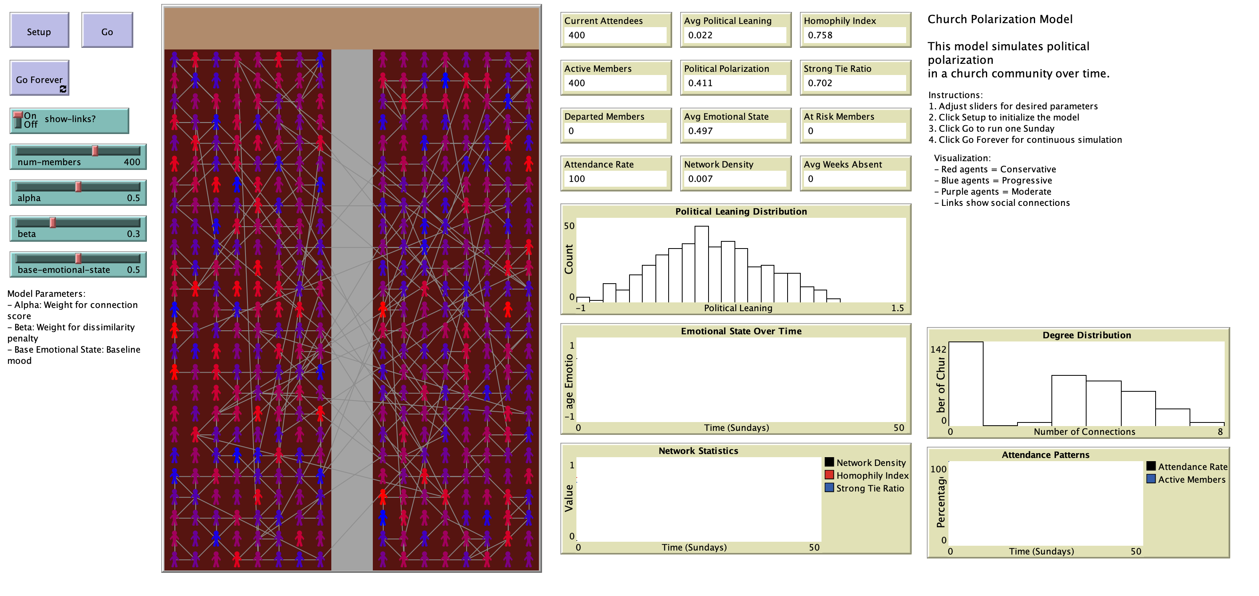

Slide 43
What do we learn from this model? First, strong social ties help buffer against polarization. When people have good friendships, they’re less likely to leave, even if there are political differences. High tolerance also reduces departures and helps maintain unity.

Slide 44
The size of the community and its initial diversity affect how stable it is. Most importantly, the model lets us test interventions—like increasing tolerance or strengthening friendships—to see what might work in real life.

Slide 45
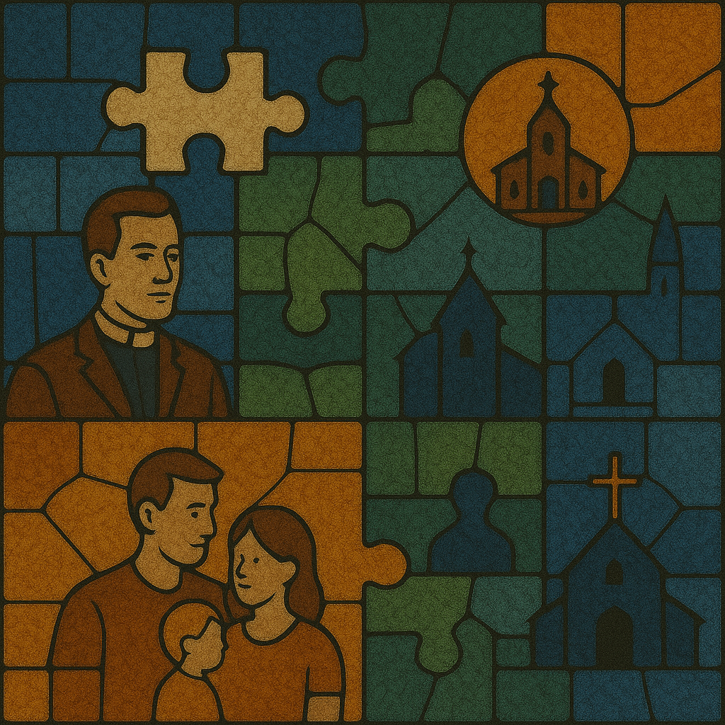
Limitations and the future of the model

Slide 46
Of course, this model is a simplification. It doesn’t include theology, leadership, or outside events that affect church life. In the future, I hope to add features like leadership effects, belief change, and interactions between multiple communities. Even so, the model gives us a useful framework for thinking about polarization in churches.

Slide 47
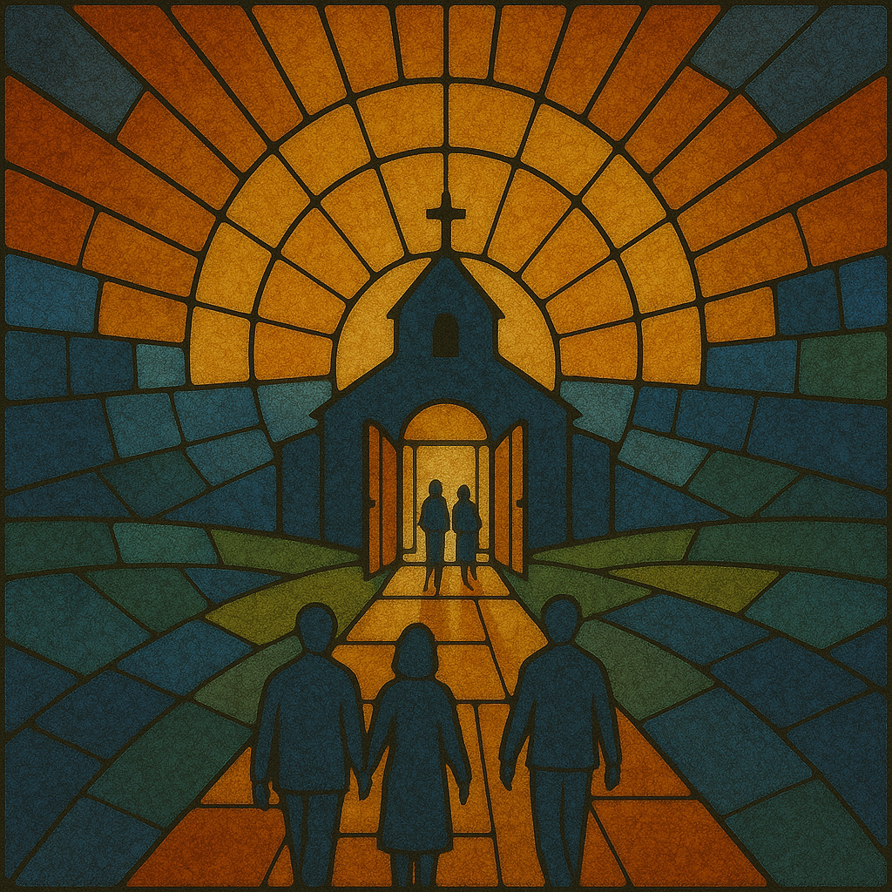

Slide 48
To sum up: polarization in churches emerges from the interaction of individual psychology, social networks, and community dynamics. Computational modeling helps us bridge theory and practice, offering insights for building unity in diverse communities. I hope this work inspires new conversations and practical steps toward healing divisions in our churches.

Slide 49
Thank you for your attention. I’m happy to take questions or discuss the model further.

Slide 50

Contact
ericaraujo.com
eric.araujo@calvin.edu

